Slide 1




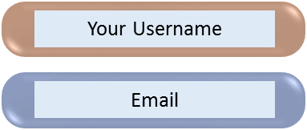




Don't have an account? Sign up Now
note
note
Your Username
Email
User Name
Password
Password
Confirm pass
Log in
Sign up
Sign in Now

Slide 2



dev
note
Your Username
Email
Password
Confirm pass
Log in
Sign up
Don't have an account? Sign up Now
Sign in Now

Slide 3

Sign in

Slide 4



Slide 5

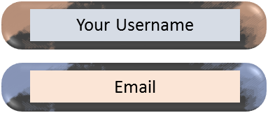
note
Log in
Don't have an account? Sign up Now

Slide 6




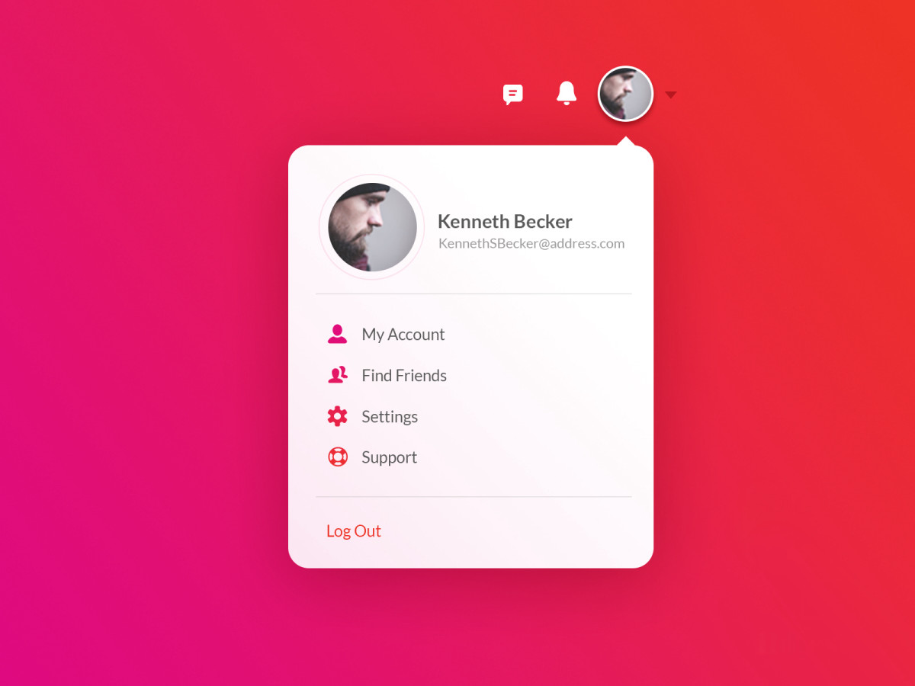


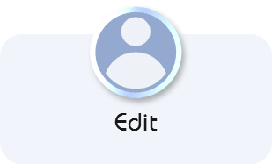

















Edit
Edit
Username : mahdi
password : 02324542813
my details
email : @yahoo.com
mahdi
email : @yahoo.com
Edit
02324542813
mahdi
mahdi@yahoo.com
Add my details
02324542813
09187472645
Mahdi@yahoo.com
09187472645
Log out

Slide 7





my details
mahdi
02324542813
mahdi@yahoo.com
09187472645

Slide 9









Slide 10



developer.android.com

Slide 11
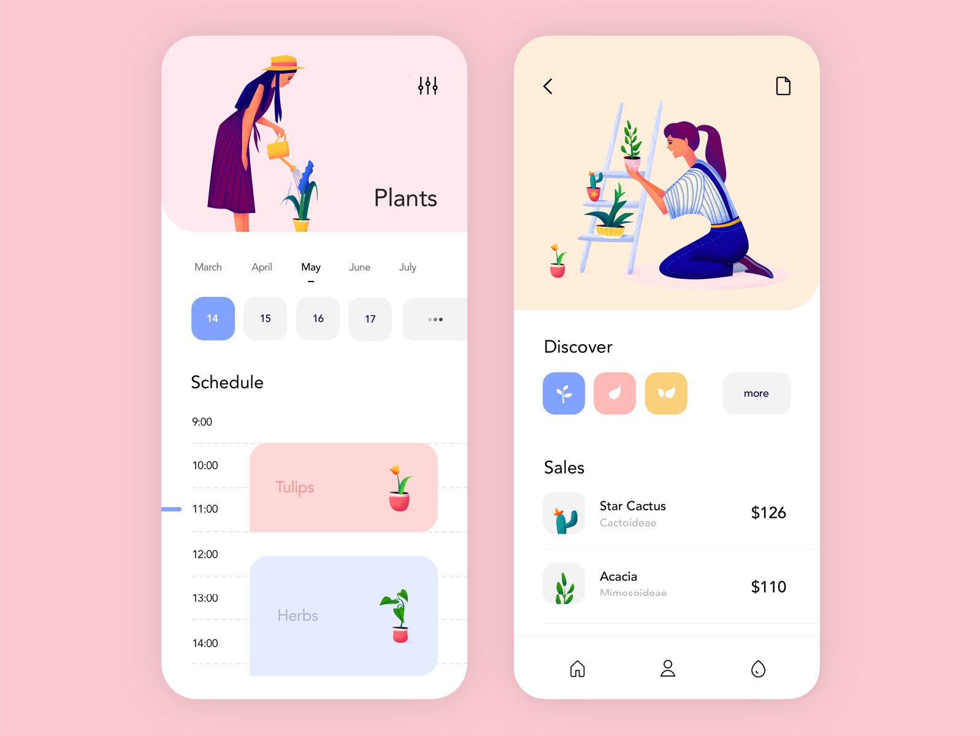









Git Tools
more
Git Tools
more
Other Tools
Other Tools
more

